Slide 1
OOPS Concepts

Slide 2
OOPS
OOPs, or Object-oriented programming is an approach or a programming pattern where the programs are structured around objects rather than functions and logic. It makes the data partitioned into two memory areas, i.e., data and functions, and helps make the code flexible and modular.
Why Do You Need OOP?
Procedural-oriented programming
Cannot reuse the code again in the program,
there was the problem of global data access
the approach couldn’t solve the real-world problems very well.
Object-oriented programming
It is easy to maintain the code with the help of classes and objects.
Using inheritance, there is code reusability, i.e., you don’t have to write the same code again and again, which increases the simplicity of the program.
Concepts like encapsulation and abstraction provide data hiding as well.

Slide 3
Basic Object-Oriented Programming (OOPS) Concept in C++
There are some basic concepts that act as the building blocks of OOPs.
Classes & Objects
Abstraction
Encapsulation
Inheritance
Polymorphism

Slide 4
Object
An Object can be defined as an entity that has a state and behavior, or in other words, anything that exists physically in the world is called an object.
It can represent a dog, a person, a table, etc.
An object means the combination of data and programs, which further represent an entity.

Slide 5
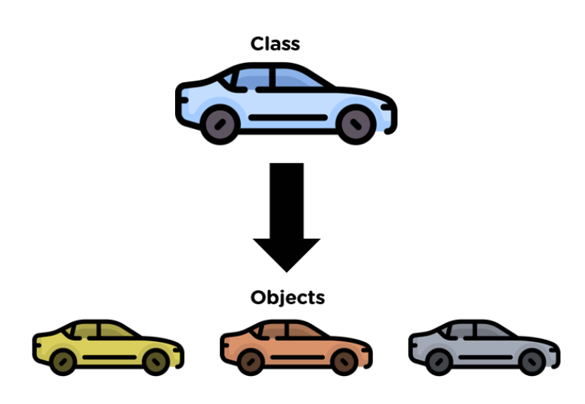
Class
Class can be defined as a blueprint of the object.
It is basically a collection of objects which act as building blocks.

Slide 6
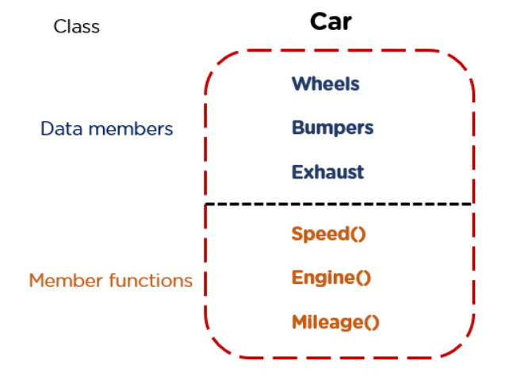
A class contains data members (variables) and member functions.
These member functions are used to manipulate the data members inside the class.

Slide 7
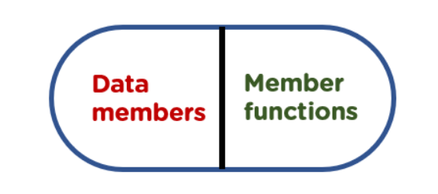
Abstraction
Abstraction helps in the data hiding process.
It helps in displaying the essential features without showing the details or the functionality to the user.
It avoids unnecessary information or irrelevant details and shows only that specific part which the user wants to see.

Slide 8
Encapsulation
The wrapping up of data and functions together in a single unit is known as encapsulation.
It can be achieved by making the data members' scope private and the member function’s scope public to access these data members.
Encapsulation makes the data non-accessible to the outside world.

Slide 9
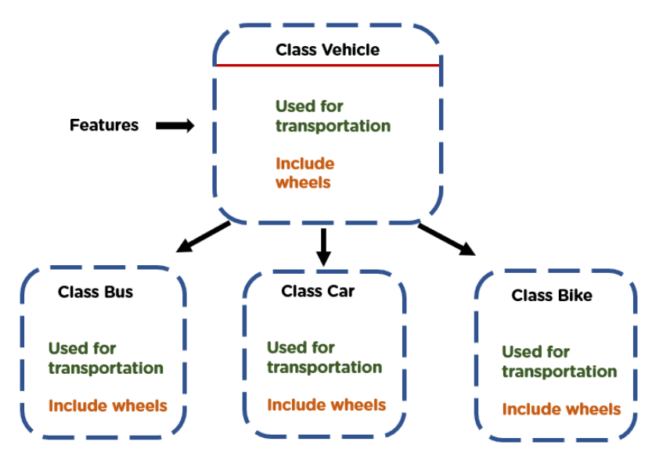
Inheritance
Inheritance is the process in which two classes have an is-a relationship among each other and objects of one class acquire properties and features of the other class.
The class which inherits the features is known as the child class, and the class whose features it inherited is called the parent class.
For example, Class Vehicle is the parent class, and Class Bus, Car, and Bike are child classes.

Slide 10
Polymorphism
Polymorphism means many forms.
It is the ability to take more than one form.
It is a feature that provides a function or an operator with more than one definition.
It can be implemented using function overloading, operator overload, function overriding, virtual function.

Slide 11
Structure of object-oriented programming?
The structure, or building blocks, of object-oriented programming include the following:
Classes are user-defined data types that act as the blueprint for individual objects, attributes and methods.
Objects are instances of a class created with specifically defined data. Objects can correspond to real-world objects or an abstract entity. When class is defined initially, the description is the only object that is defined.
Methods are functions that are defined inside a class that describe the behaviors of an object. Each method contained in class definitions starts with a reference to an instance object. Additionally, the subroutines contained in an object are called instance methods. Programmers use methods for reusability or keeping functionality encapsulated inside one object at a time.
Attributes are defined in the class template and represent the state of an object. Objects will have data stored in the attributes field. Class attributes belong to the class itself.

Slide 12
OPP Languages
C++
Java
Python
Ruby
PHP
Cobol
Scala
C#
VB
etc

